Slide 1
The Story of
st. joseph high school
By: Sarah Matro

Slide 2
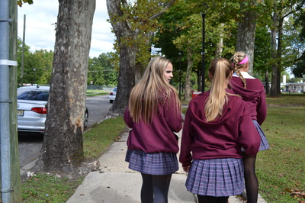
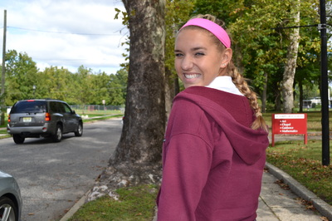
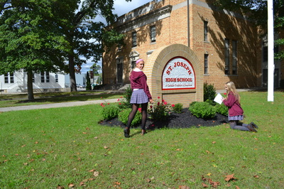
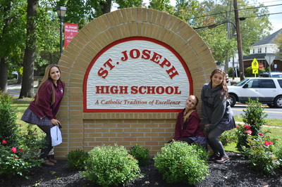

Slide 3
Build Friendships
Here at St. Joe you make friendships that will last a lifetime. All of the kids are so welcoming and nice.

Slide 4
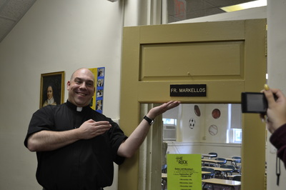
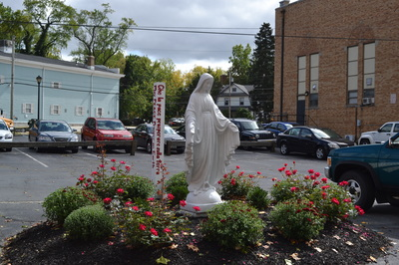
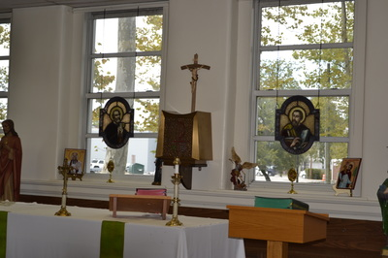
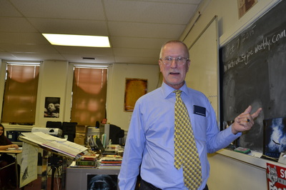

Slide 5
Catholic
St. Joseph is a Catholic School. We have religion in our daily school life.

Slide 6
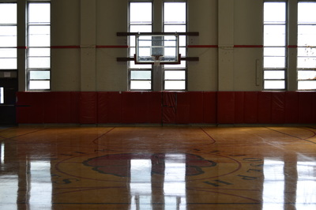
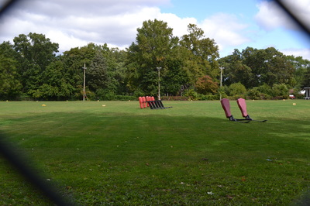

Slide 7
Sports
We have many sports to offer at St. Joe like Basketball and Football. All of our sports programs do very good each year.

Slide 8
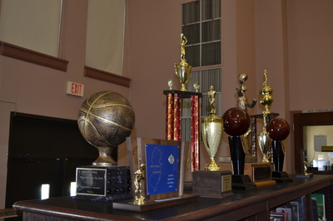
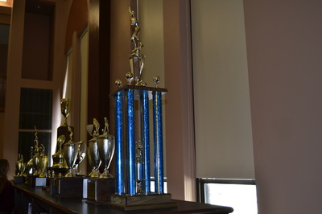
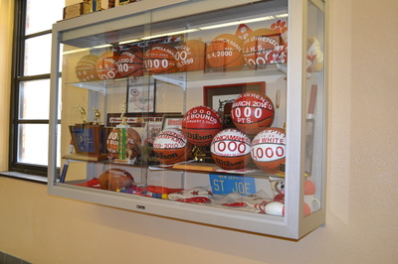

Slide 9
Trophies
St. Joe is very well known for sports. From our football team to our field hockey team most of the teams win their conference. The football team wins the state title.

Slide 10
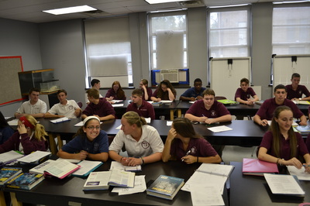
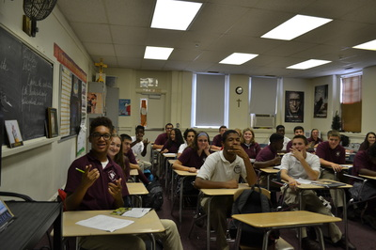

Slide 11
classes
the students at St. Joe take their work very seriously. We have a very good teachers who teach us everything we know in the classroom.

Slide 12
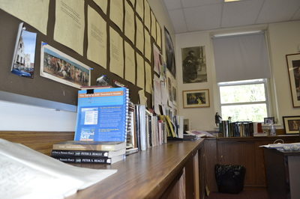
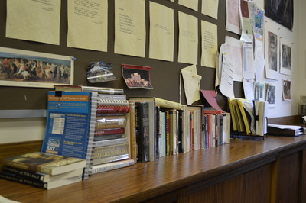

Slide 13
Books
We are offered a very nice library with many different books. We also have many books that we can look at in the classroom.

Slide 14
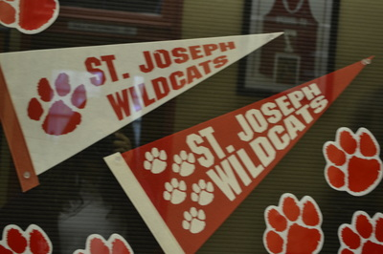

Slide 15
School Spirit
We have many school spirit when it comes to the school. We have pep rallies, we decorate the lockers, and a lot of people come to support one another during sporting events.

Slide 16
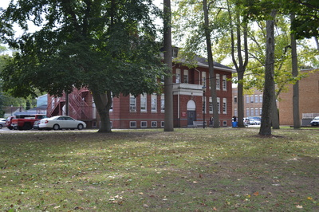

Slide 17
School
Our school is a very family oriented school. It has been opened since 1922 but came to this building in 2003.

Slide 18
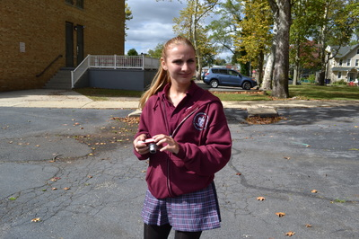
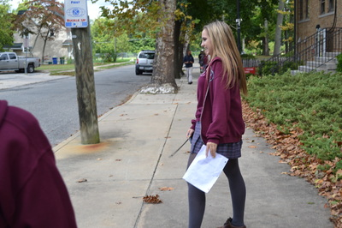

Slide 19
Uniforms
we wear uniforms to show that we are one and so that we don’t

